Slide 1

Taquill: Launching Sustainable Athletic Wear in Spain
Marketing Concepts
CEO and CFO, Jake Takeuchi and Will Rueb

Slide 2
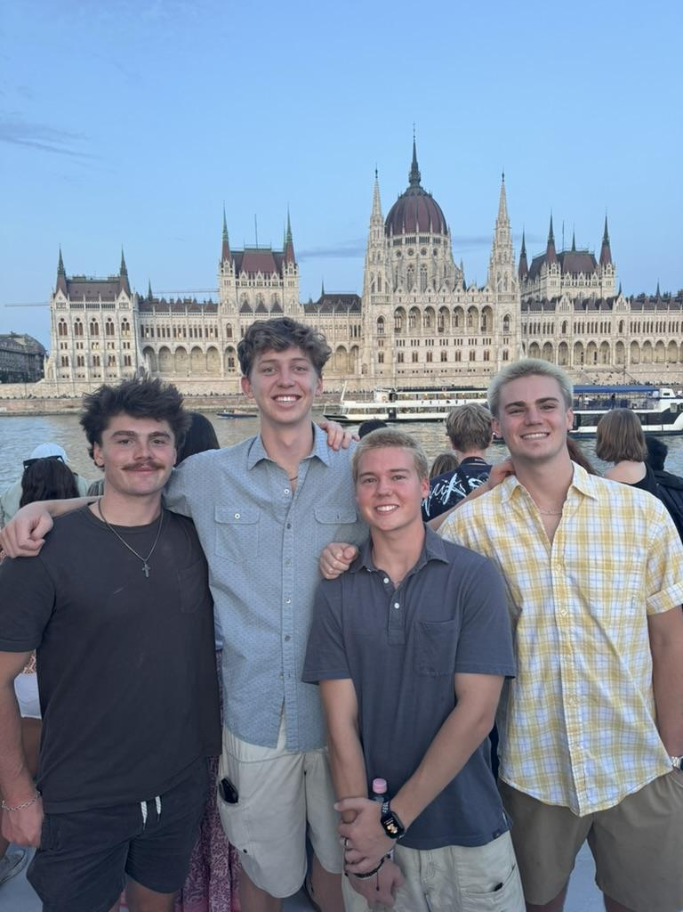
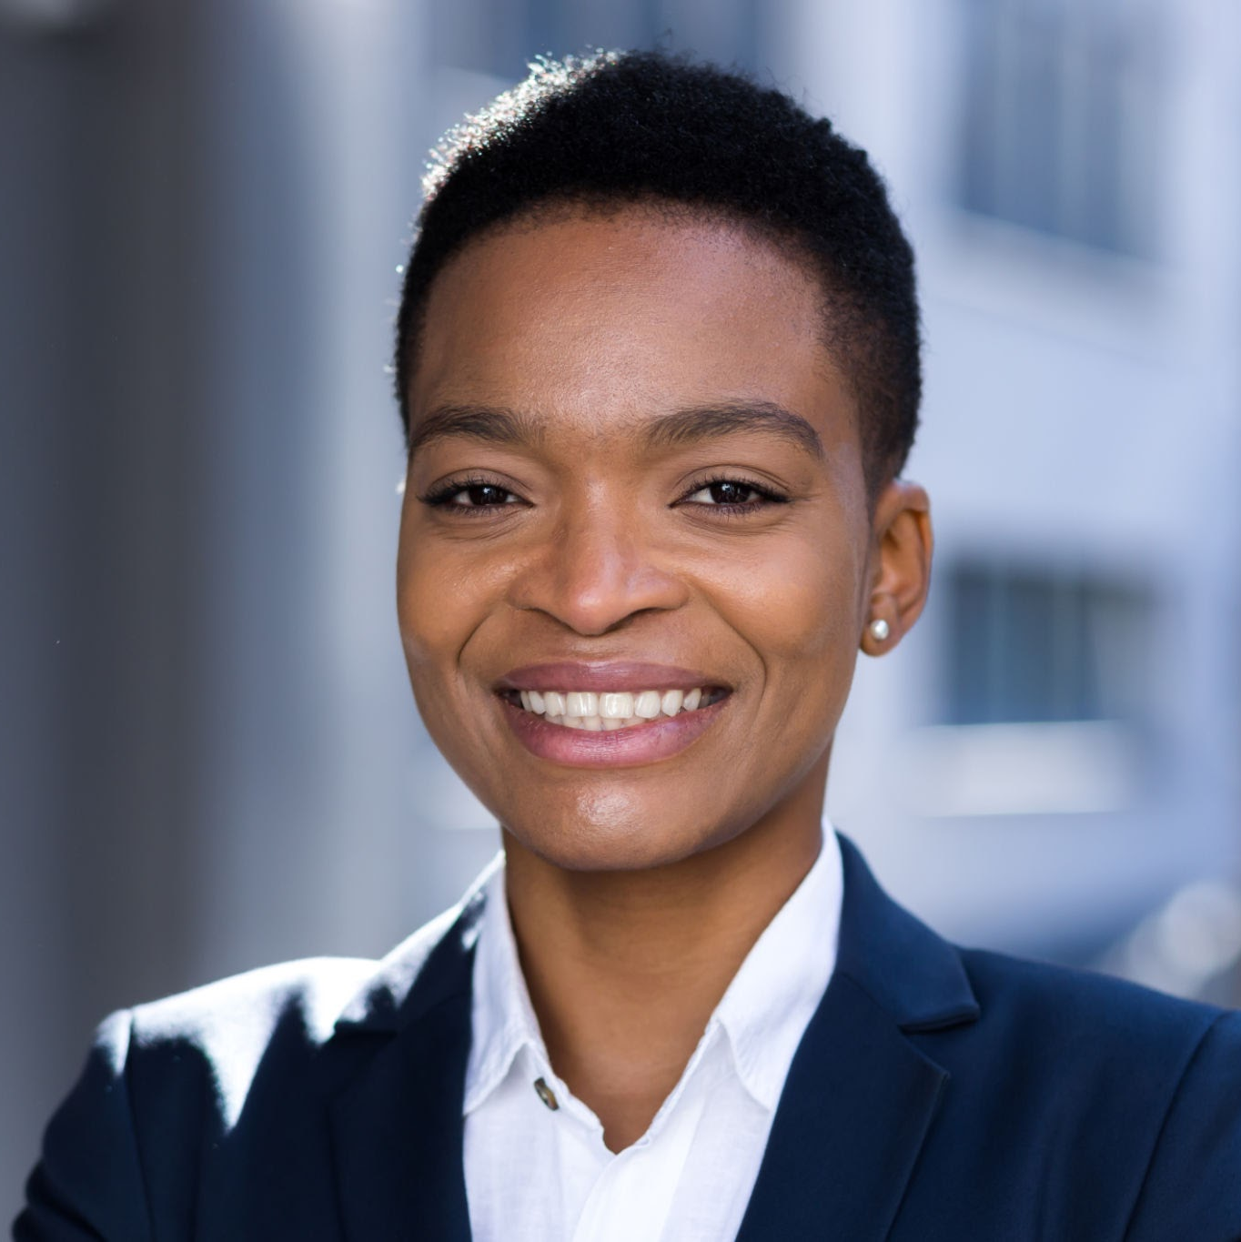
Our Team
Company Name
CEO
CFO
Jake Takeuchi
WIll Rueb
Leader of organization and a great captain for the team.
Manages all finances and doesn’t let anything slip through the cracks.

Slide 3
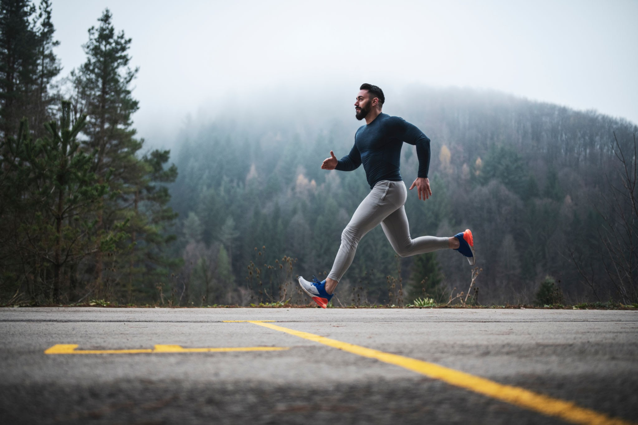
Why Taquill?
1
2
3
Athletic wear market is worth 1.6 billion and growing.
Gen Z and Millenials
Gap in market: ethical, stylish, affordable brands

Slide 4

Our Brand
Launching Q1 2026 (online)
Values: sustainability, function, transparency
Target ages: 18-35, health-conscious

Slide 5

Political: EU sustainability push, stable trade
Economic: Rebound in spending, especially fitness/lifestyle
Social: Gen Z shopping values, ethics over hype
Market Environment

Slide 6
Social Media: main channel (92% IG daily use)
EU’s Green Claims Directive: forces transparency
Textile Tech: recycled fabrics, low impact dyeing
Tech & Legal Factors

Slide 7


Nike & Adidas = big but lack trust
Oysho = women-focused, not transparent
Patagonia = great values, but expensive and low Spanish presence
Taquill = ethical, stylish, affordable, Spain-first
Our Competitors

Slide 8

Launch: Performance tee (€39.99), shorts (€49.99), jacket (€89.99)
Materials: Recycled polyester, organic cotton, eco-shell
Mid-premium pricing; limited drops
Product & Pricing

Slide 9
Online only at launch (taquillwear.com)
Pop-ups in Barcelona/Madrid gyms & studios
Fulfillment hub in central Spain
Distribution & Sales

Slide 10
Campaign: “Wear What Moves You”
TikTok & Instagram influencers
UGC contests + “Recycle for Reward” program
Promotion Plan

Slide 11
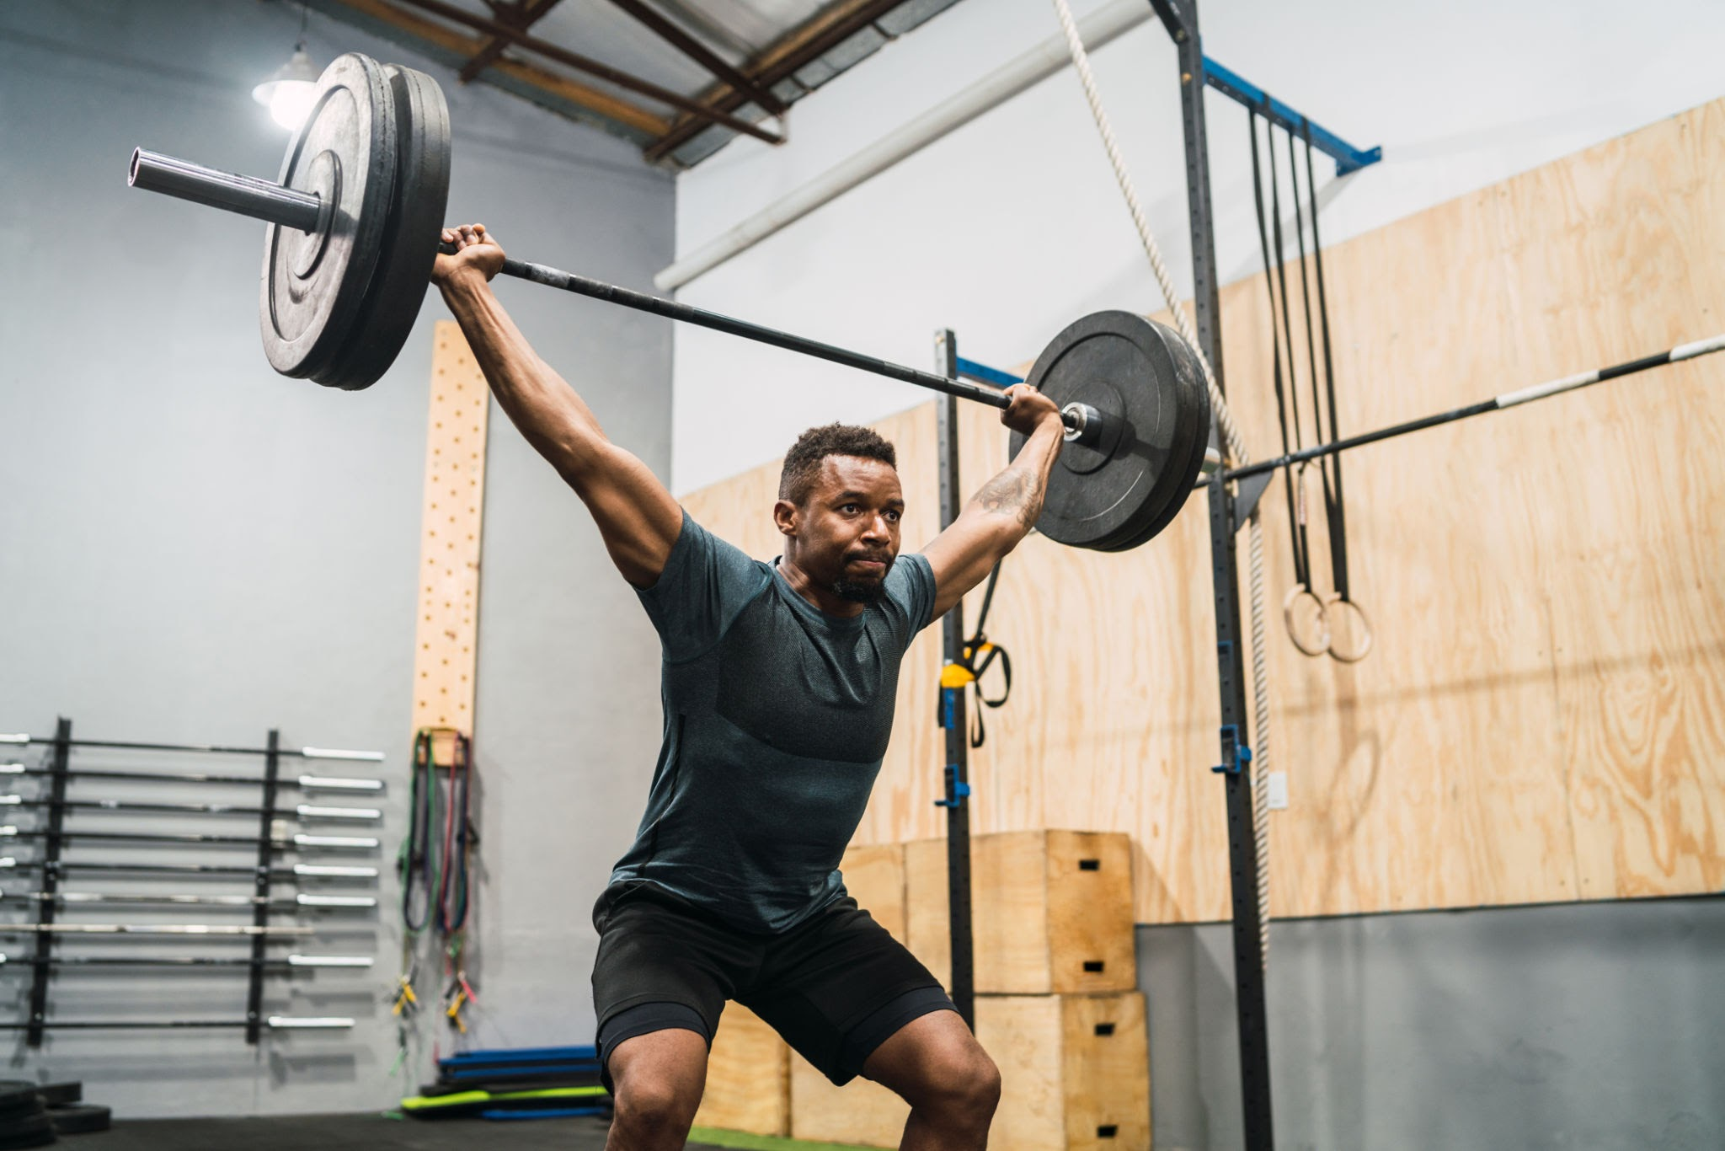
Conclusion
Last thing,
.
The market’s changing — and we’re built for it
Young consumers want more than just gear
Taquill delivers: style, substance, and sustainability
Contact
taquill@org.co

Slide 12
https://share.icloud.com/photos/040V_j71loDJY66QgxFAB1n_g

Slide 13
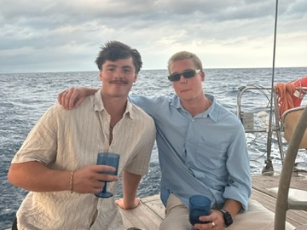
Questions? We are open to all types of questions.

